Slide 1
Renewable Energy Potential in India
India is increasingly focusing on renewable energy sources as part of its sustainable development and climate action efforts.
As of March 31, 2024, the total estimated potential for renewable power generation in India stood at 2,109,655 MW.
This potential comes from a variety of renewable sources, including wind, solar, biomass, small hydro, and cogeneration from bagasse

Slide 2
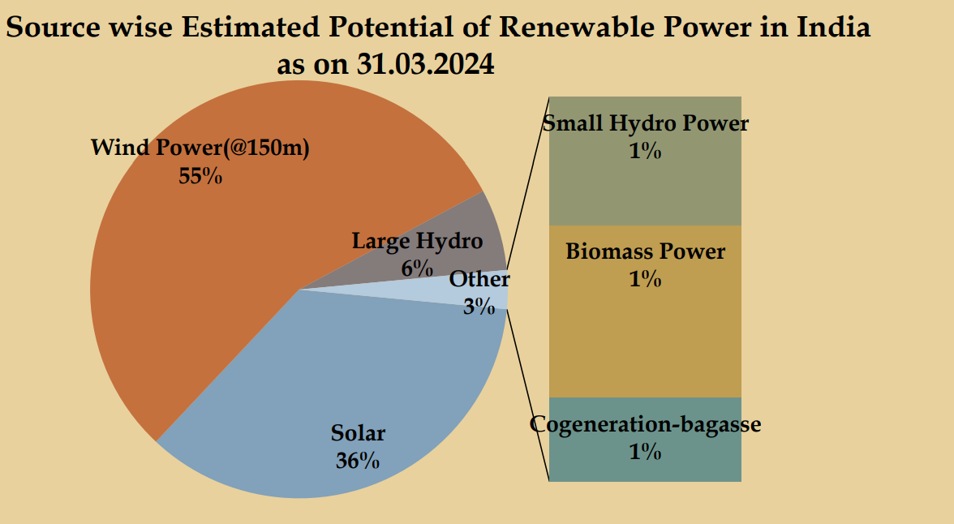
Renewable Energy Potential in India

Slide 3
Renewable Energy Potential in India
Potential is spread across several key renewable energy sources, as detailed below:
Solar Power: India has immense potential for solar power generation, estimated at 748,990 MW, which accounts for 36% of the total renewable energy potential.
Wind Power: With an estimated potential of 1,163,856 MW (55% of total renewable energy potential), wind power stands as the most significant source of renewable energy in India.
Large Hydropower (Large Hydro): The potential for large hydropower generation is estimated at 133,410 MW, contributing 6% to the country's renewable energy potential.
Small Hydro Power (SHP): India also has a notable potential of 21,134 MW (1%) from small hydro power projects.

Slide 4
Renewable Energy Potential in India
Biomass Power: Biomass, which includes agricultural waste, forest residues, and other organic matter, has a potential of 28,447 MW, accounting for 1% of the total renewable power potential.
Cogeneration from Bagasse: India has a specific potential of 13,818 MW (1%) from bagasse-based cogeneration in sugar mills. This is a highly efficient form of energy generation, especially in regions with a robust sugar industry.

